Slide 1

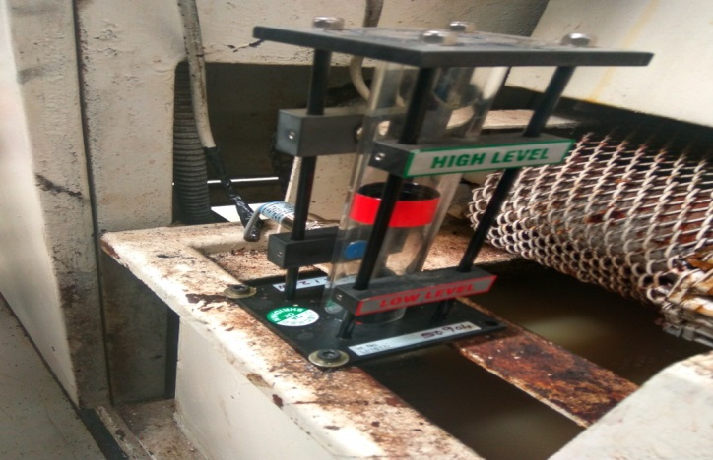
AHPL/QMS/FR/09/E
TPM CIRCLE NO :-
ACTIVITY
KK
QM
PM
JH
SHE
OT
DM
E&T
KAIZEN IDEA SHEET
TPM CIRCLE NAME:
LOSS NO. / STEP
DEPT :-Maint.
RESULT AREA
P
Q
A
C
D
S
M
CELL:-Machine Shop
CELL NAME:- Drum Change
MACHINE / STAGE :- D/C Washing Machine
OPERATION :- Job Washing
KAIZEN THEME : Cost Saving
IDEA :-Use coolant level indicator for OFF coolant motor when coolant level low
Problem present status :- Coolant leakage through pump
COUNTERMEASURE:-
BENCHMARK
12500
TARGET
0
KAIZEN START
10.1.2017
TDC
KAIZEN FINISH
15.1.2017
TEAM MEMBERS : Rahul Gaikwad
NO COOLANT LEVEL INDICATOR
BENEFITS :- 1) Cost Save
Before
After
KAIZEN SUSTENANCE
WHY - WHY ANALYSIS :-
Coolant leakage through pump
Pump seal early wear
Pump Dry run
Coolant level low
No any devise for indication
RESULT :-
WHAT TO DO:- Tight Connection of sensor
HOW TO DO:- In PM
FREQUENCY :- Monthly
Cost Save
ROOT CAUSE :- Mfg. Designed Defect
REGISTRATION NO. & DATE : 15 .1.2017
SCOPE & PLAN FOR HORIZONTAL DEPLOYMENT
REGISTERED BY :- Rahul & Shubham
SR.
NO.
CELL
TARGET
RESPONSIBILITY
STATUS
MANAGER’S SIGN :- SNC
1
Cleaning
25.2.17
Rahul
C

